Slide 1
Lesson 1
Introduction
ICS 3112
Legal and Ethical Aspects of Computing

Slide 2
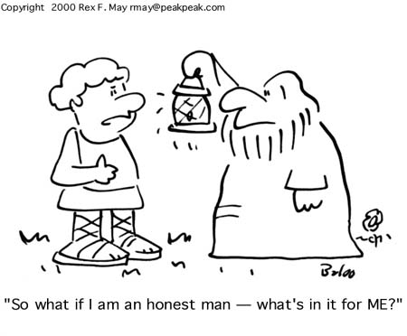
Contents
Dilemma in ICT society
Ethical principles and guidelines
ICT Professionalism
Notes:
Designers of computer systems often have a larger social and ethical impact than they realize or intend. Should have codes of conduct to guide? what are the appropriate codes? how to ensure that ethical considerations are properly addressed?

Slide 3
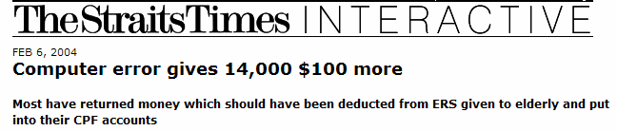
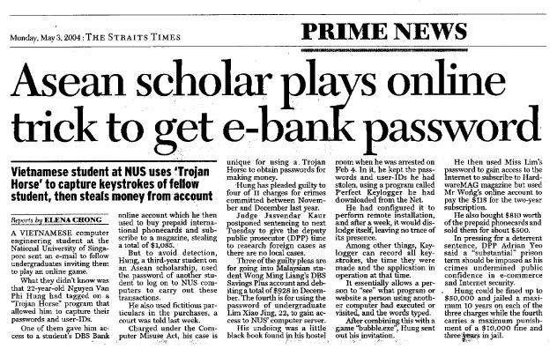
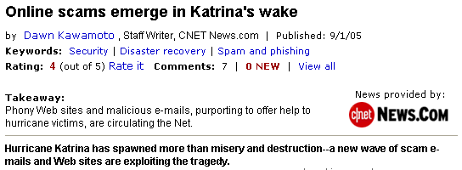
News on ICT
Microsoft vs. Google:
Lawsuit over Kai-Fu Lee
Notes:
Phony Web sites and e-mails, purporting to offer help to hurricane victims or provide more news on the destruction, are making their rounds on the Internet, security experts said Thursday.

Slide 4
Challenges from ICT
Key Problems
  Evolving technology
  Lack of/inadequate legal framework
  Difficult to establish ground rules (different contexts of use, different cultures)
  Difficult to monitor compliance
  Conflicting stakeholder interests
  Different perceptions about the ethical issues
  Responsibilities to different stakeholders
Conceptual muddles
Policy vacuum
Privacy ⬄ Security
Vendor ⬄ Client
Notes:
Conflicts
Piracy of digital IP vs rights to access information
Spam, harassment, porno spread vs freedom of expression
Privacy vs e-Commerce activities, work-place monitoring for productivity

Slide 5
Ubiquity of ICT
Self-Indulgence
Freedom
to take, to use, to express,…
        Abuse in workplace
  Violation of rights
    Others’ privacy
    Intellectual property
  ICT crimes

Slide 6
ICT Crimes
Web site defacement or vandalism
Denial of service attacks on websites and online services
Theft of customer data
Theft of electronic intellectual property
Theft of Internet & Telephone services
Sabotage of data or networks
Financial and On-line Securities Fraud
Forgery, illegal interception & ID Theft
Payment card fraud & e-funds transfer fraud
Pornography/Child Pornography; cyber-stalking
On-line Gaming/Betting
Commercial/Corporate Espionage
Extortion & criminal conspiracy communications
Disruption of essential or critical network services

Slide 7
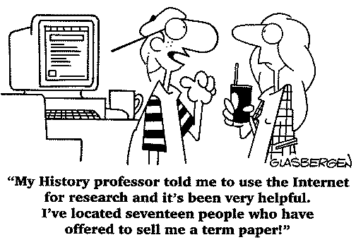
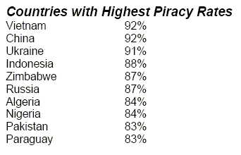
Freedom to take …
Year 2003
Global Piracy Rate: 36%

Slide 8
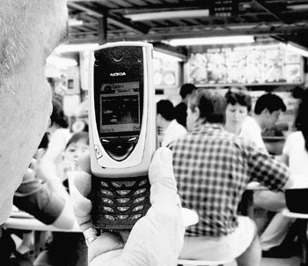
Freedom to …
Take photos!

Slide 9

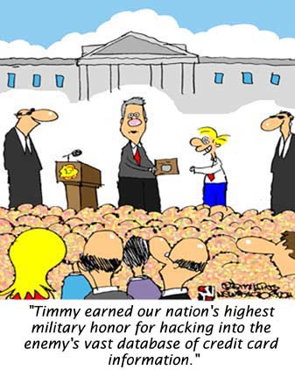
Freedom to …
Hack!
Distribute!

Slide 10
Freedom of Expression
A Fundamental Right
“Everyone has the right to freedom of opinion and expression; this right includes freedom to hold opinions without interference and to seek, receive and impart information and ideas through any media and regardless of frontiers.”
UN Universal Declaration
of Human Rights, Article 19

Slide 11

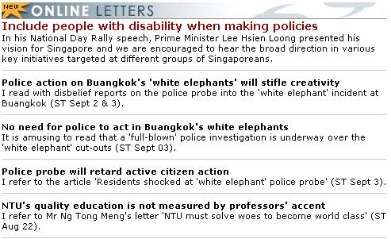
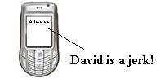
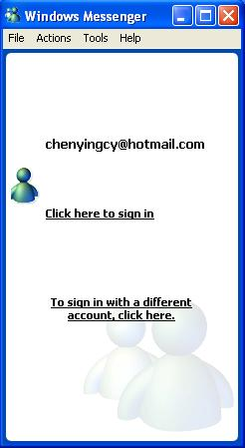
Freedom of Expression
So many possibilities/avenues in ICT
  Blog
  Forum
  IM/SMS/Email
Notes:
Easy and far-reaching.

Slide 12
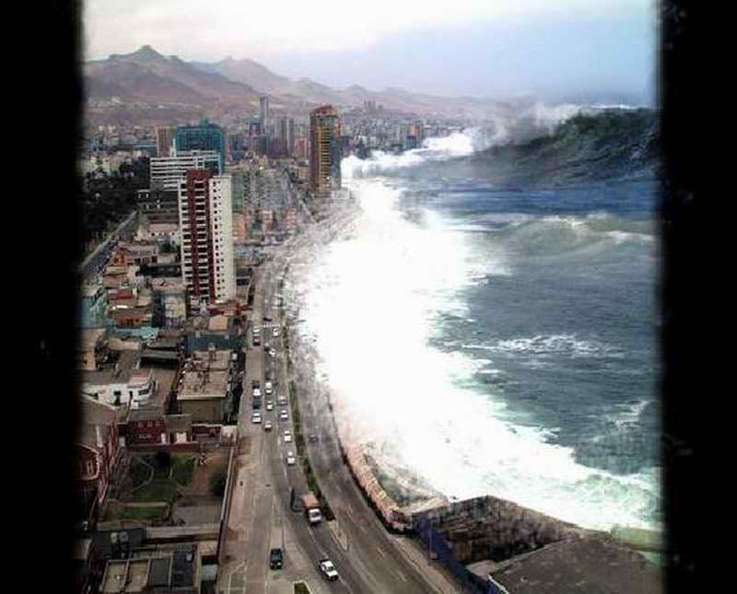

Freedom of Expression
Image manipulation
Digital IP rights
Notes:
- digitized information is easily copied and altered, easily transferred across borders
- multimedia works are often a mix of digitized resources. how significant must a component of such a work be before the user must pay coypright royalties?

Slide 13
Freedom of Expression
You receive a joke message, …
You receive a ‘warning’ message, …
You want to expose some injustice, …
You want to publicise/sell, …
Responding to an online-petition
Notes:
Reaction can also mean something.

Slide 14
Abuse at Workplace
Web-surfing
  Travel booking
  On-line shopping/trading
  Hobby pursuit
File-downloading
  Movies
  Music
  Images
“The best time to trade is during business hours.”

Slide 15
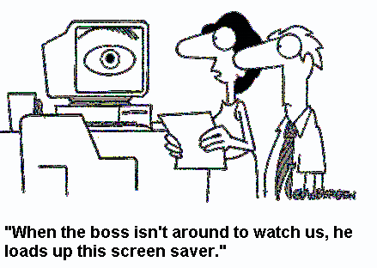
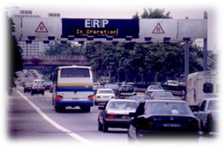
Challenges from ICT
Privacy at risk!

Slide 16
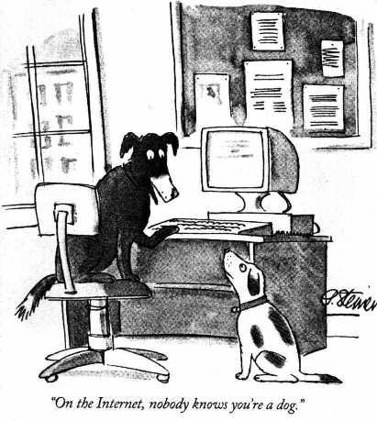
Privacy
Freedom from interference or intrusion
Oxford English Dictionary
“The right to be left alone”
Anonymity protects privacy to …
  cyberstalkers
  peodophiles
  terrorists
or dogs!

Slide 17
Ethics
What is it?
  a code
  a collection of principles
  about right and wrong
  to apply on judgment or action/behavior
Most people are ethical most of the time
Used in critical thinking, consciously or subconsciously
Notes:
“do the right thing.”
Ethics are moral standards that help guide behaviour, actions, and choices.
Ethics are grounded in the notion of responsibility (as free moral agents, individuals, organizations, and societies are responsible for the actions that they take) and accountability (individuals, organizations, and society should be held accountable to others for the consequences of their actions). In most societies, a system of laws codes the most significant ethical standards and provides a mechanism for holding people, organizations, and even governments accountable.

Slide 18
What is Computer Ethics?
  James H. Moore is believed to have first coined the phrase "computer ethics“ as the analysis of the nature and social impact of computer technology and the corresponding formulation and justification of policies for the ethical use of such technology.
  Moore's definition focuses on the human actions that are routed in computer technology or influenced by computer technology.
  In other words, it is a study, an analysis of the values of human actions influenced by computer technology.
  Computer influence on human actions is widespread throughout the decision making process preceding the action.

Slide 19
The Emergence of Social and Ethical Problems in Computing
  The history of computer crimes started with the invention of the computer virus.
  The term virus is derived from a Latin word virus which means poison. For generations, even before the birth of modern medicine, the term had remained mostly in medical circles, meaning a foreign agent injecting itself in a living body, feeding on it to grow and multiply.
  As it reproduces itself in the new environment, it spreads throughout the victim's body slowly disabling the body’s natural resistance to foreign objects, weakening the body’s ability to perform needed life functions and eventually causing serious, sometimes fatal effects to the body.
  A computer virus, defined as a self-propagating computer program designed to alter or destroy a computer system resource, follows almost the same pattern but instead of using the living body, it uses software to attach itself, grow, reproduce and spread in the new environment.
  As it spreads in the new environment, it attacks major system resources that include the surrogate software itself, data, and sometimes hardware weakening the capacity of these resources to perform the needed functions and eventually bringing the system down.

Slide 20
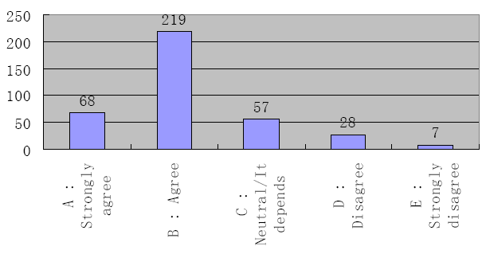
Ethics Survey
“Every company should institute information monitoring on employees' ICT activities to check for illegal materials such as pornography. ”

Slide 21
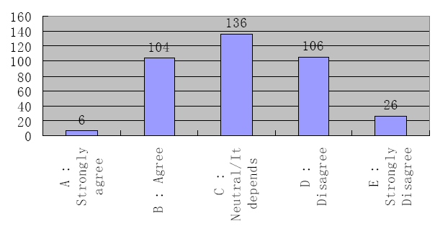
Ethics Survey
“Every company should institute information monitoring on employees' ICT activities to control gossips and dirty jokes.”

Slide 22
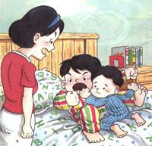
Ethics-related Concepts
Morals
  Principles ingrained from childhood
Conscience/Guilt
  Feeling about right/wrong
Laws
  Principles and regulations established and enforced in a community
Rights
  Entitlements
Duties
  Obligations
Natural laws: right to self-defense
Conventional laws: culture-dependent
Cultural vs professional principles
Notes:
Cultural principles more applied in human relationship.

Slide 23
Rights and Duties
Rights imply duties
Duties command rights
A’s duty
A’s right
Provide good software
Fair monetary return
B’s right
B’s duty
Expect quality software
Pay the price

Slide 24
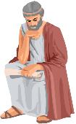

Basic Ethical Theories
Teleological (Consequentialism/Utilitarinism)
  Greek word teleos means end or goal
  result-oriented
  human actions judged good or bad, right or wrong, depending on results of such actions
Deontological
  Greek word deon means obligation
  duty-driven
  action is good or bad depending on the will inherent in it regardless of consequences

Slide 25
Teleological Theories
Ethical Utilitarianism
  argues for the priority of the good over the right
  evaluates actions by the goal or consequences
  right action is one that produces the most good consequences
Ethical Egoism
  self-interest
  justify fostering of one’s own welfare
Ethical Altruism
  interest of others
A cartoon strip
  puts group’s interest and happiness above those of an individual
  strives to achieve “the greatest happiness for the greatest number”
Notes:
To increase “happiness” or “utility”

Slide 26
Deontological Theories
argue for the priority of the right over the good
view that actions are intrinsically ‘right’ or ‘wrong’ regardless of consequences
Duty-based Ethics
  Perform actions for the sake of duty regardless of consequences
Rights-based Ethics
  Focus on individual rights and respects for those rights
  Closely related to duty-based ethics since rights and duties are correlative

Slide 27
On Software Piracy
Deontological Theories
Teleological Theories
“Software piracy is wrong no matter what because it infringes intellectual property rights.”
“Since piracy promotes public awareness and familiarity which in the end helps the software developers, they should be tolerated.”

Slide 28

Basic Ethical Principles
Ethics of Reciprocity
  Treat other people in the same way that you would like them to treat you.
“Do unto others as you would have them do unto you.”
The Golden Rule from Bible
“This is the sum of duty: do naught to others which if done to thee would cause thee pain.” The Mahabharata (Hinduism)
“Hurt not others with that which pains yourself.”
Udana-Varga (Buddhism)
“No one of you is a believer until he desires for his brother that which he desires for himself.” Hadith (Islam)
“Seseorang tidak bisa disebut beriman sebelum dia mengasihi sesamanya seperti mengasihi dirinya sendiri”
“ “Do not impose on others what you yourself do not desire.”
Confucius, Analects

Slide 29
Simple Ethical Guidelines
The Mum Test
  Whether the individual will be proud or ashamed of an action, and whether they would tell their mother what they did
TV Test
  How the individual would feel if they saw their situation described on TV, whether their action would make them appear good or bad
Other Person’s Shoe Test
  What if the roles were reversed? Would the individual be happy if the act were done to them?

Slide 30
Ethical Decision Making
Distinguish between harm and wrong
  telling lie under gun point
  accepting a job to replace someone who needs income more badly
Distinguish between goal and action or constraints
  Writing good code for a porno website
Distinguish between personal preference and ethics
  sending threat emails to homosexual sites?

Slide 31
Ethical Decision Making
Types of Ethical Choices
  Choosing right from wrong
  Choosing right from right
Choosing the most right
Choosing the least wrong
  Meeting a software project deadline
  work overtime
  “borrow” code from another
  argue for more time
  sacrifice user friendliness
  sacrifice data protection
  quit
  …

Slide 32
Ethical Decision Making
Procedure
  List facts
  Identify stakeholders
  List possible actions/options
  Consider their impact on the stakeholders
  Identify responsibilities of the decision makers and rights of the stakeholders
  Distinguish between ethical and legal issues
Stakeholder:
a person or organization with a stake in the decision.
Benefits, gains
Damages, disadvantages

Slide 33


Characteristics of Professionals
Mastery of an esoteric body of knowledge, usually through higher education
Autonomy in work
Recognized professional organization
Important social function / Commitment to social good
ICT professional
no single professional organization for ICT professionals, not compulsory
more remote from his customers

Slide 34
Computer Ethics
  Two schools of thought.
  One believes in the study of computer ethics as remedial moral education.
  The other school believes in computer ethics education not as a moral education but as a field worthy of study in its own right.
  Based on two views:
    (i) certain ethical issues are so transformed by the use of computers that they deserve to be studied on their own, in their radically altered form,
    (ii) the involvement of computers in human conduct can create entirely new ethical issues, unique to computing, that do not surface in other areas.
  There are six levels of justifications for the two views, the first two for the first school and the last four for the second school:

Slide 35
Why Study Ethical Issues?
    To make us behave like responsible professionals.
    To teach us how to avoid computer abuse and catastrophes.
    The advance of computing technology will continue to create temporary policy vacuums.
    The use of computing permanently transforms certain ethical issues to the degree that their alterations require independent study.
    The computing technology creates novel ethical issues that require special study.
    The set of novel and transformed issues is large enough and coherent enough to define a new field.
  Whatever school one falls in, there is enough justification to study computer ethics.

Slide 36
Scenario 1
John discovers a pirated version of the software available free on a popular Warez website.
John downloads and uses the software.
Would you do the same?
Notes:
Would you do the same?
The action will not cause any harm in the immediate future.
The action is unlikely to be negatively affecting anyone closely related.
The action will not cause any major loss of revenue by the software company.
Everyone else is doing it.
To what extent do you believe that X's action is associated with the following consequences?
Not at all Moderate extent Great extent
More unfairness and injustice in our society
Legal troubles to be experienced by X's employer
Bad influence on X's family members and friends
Loss of revenue by the software company

Slide 37

Scenario 2
Copyright association advertisement announces rewards…
You find pirated software in your company …
You find pirated VCD/DVD in your uncle’s house …
What would you do?

Slide 38
Scenario 3
You are a member of a team working on a computer-controlled crash avoidance system for automobiles. You think the system has a flaw that could endanger people. The project manager does not seem concerned and expects to announce completion of the project soon.
What would you do?

Slide 39
Scenario 4
A website secretly operating a pornography business has offered you a very attractive employment contract to work for them.
What would you do?

